Slide 1

Analytics
FROM THE COSMETIC INDUSTRY
Gregory Sharpe
Notes:
Have a “keep it simple stupid ” slide explaining why simple models were used.

Slide 2
1
2
3
AGENDA
Introduction
Dataset
Data Analysis
Describing motivation and purpose
Brief dataset description
Exploring trends, patterns and correlations
6
5
4
Next steps
Key Findings
Modelling Approach
Future work and Q&A
Interpretations, impact and stakeholder relevance
Use of techniques and statistical models
Non-technical
Technical
Notes:
The technical gradient doesn’t look too good in practice.

Slide 3
In a post-pandemic world, women are more likely to purchase from online giants, like amazon, than in person where they can try new products
Brand loyalty is important: “It can cost over 7 times as much to acquire a new customer than to maintain one”
“More than two-thirds of women are likely to recommend their beauty products to friends if they like them”
of people who have recently purchased a beauty product, only 7% had not made any purchases based off of a blogger.
MOTIVATION
As annual income increased, the rate of switching brands also increased
1 in 5 women said it had been a year or more since they last switched up their beauty routine
Notes:
Bring up an anecdote of group of girls spending hours together putting on makeup before a night out.
Recommendations from online bloggers can sell-out a product but the effect is still prominent on a smaller scale with friendship networks.

Slide 4
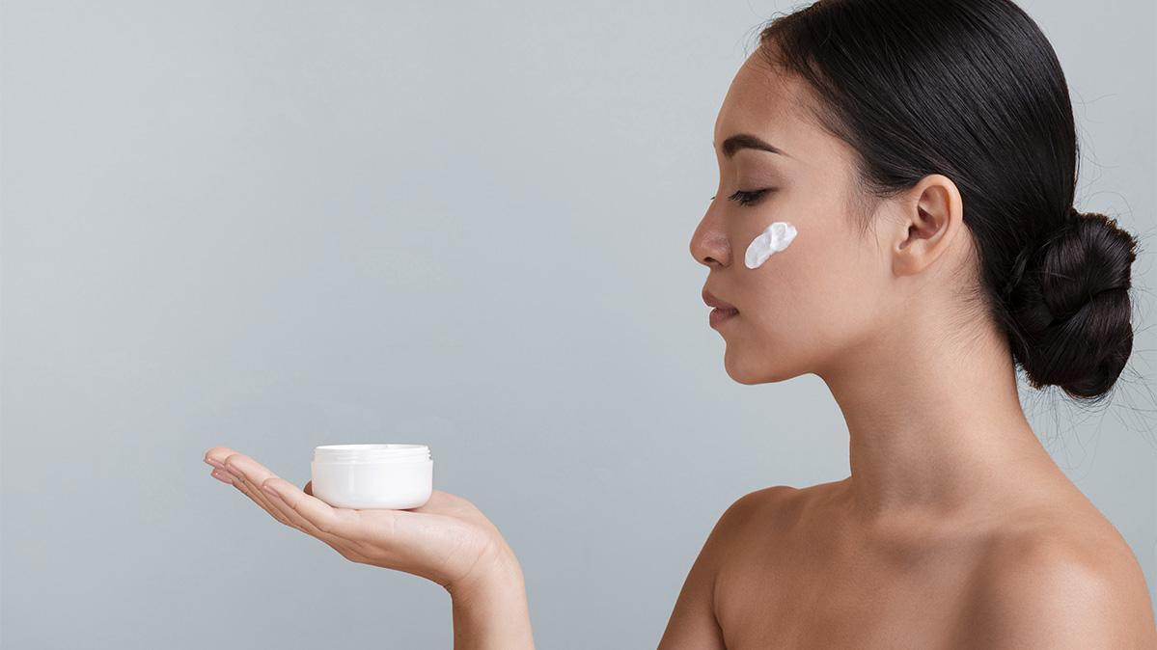
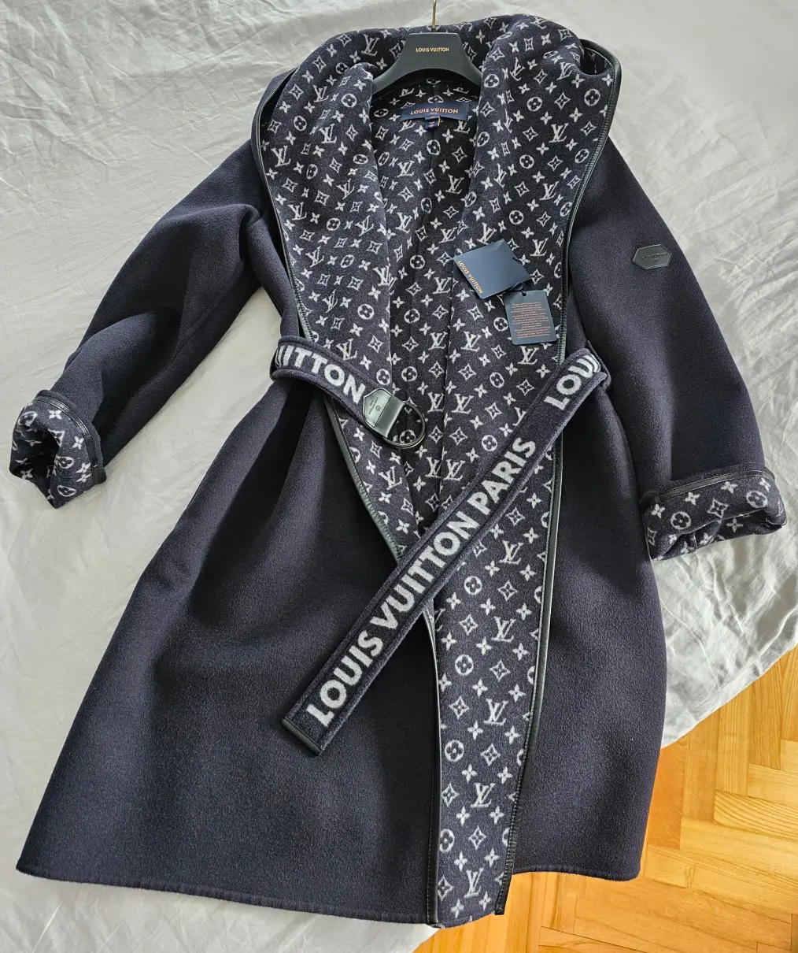

It’s not easy to see what cosmetic brands people use
LV

Slide 5
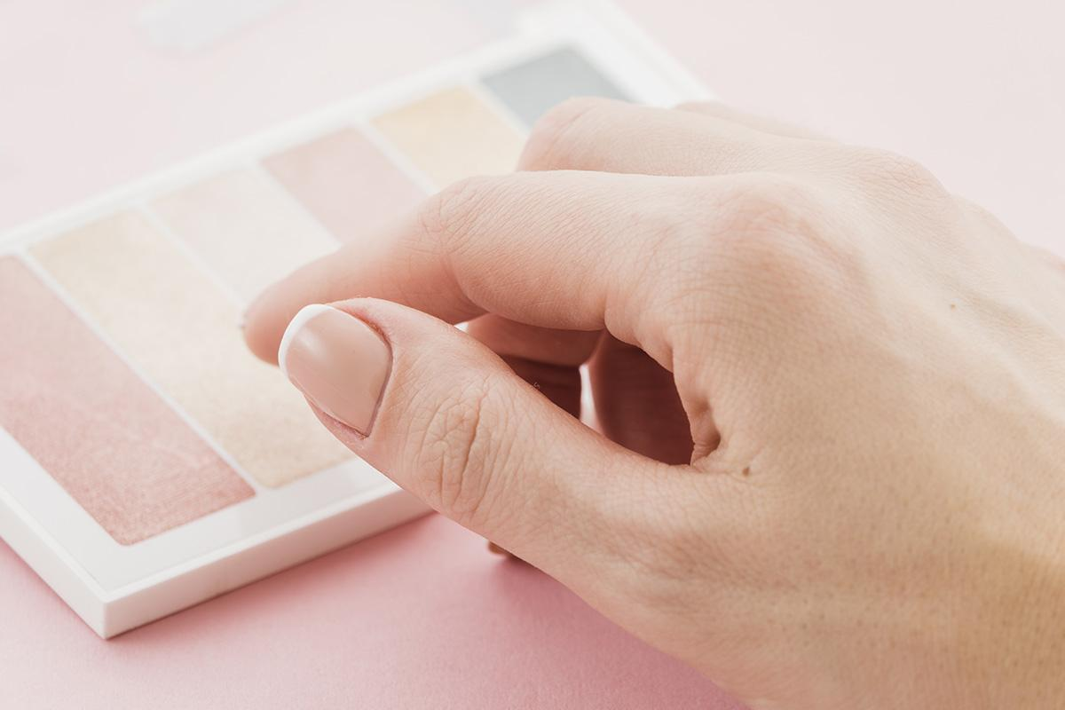
ABOUT THE DATA
Collected from a survey
Includes 23 different brands
Opinions based on “Strongly Agree”, “slightly Agree”, “Neither…”, etc
1233 people surveyed
UK and US markets only
Notes:
Include other less meaningful stats here
Move on before people look bored

Slide 6
RECIPIENT PROFILE
GENDER
0%
100%
Men
Women

Slide 7
Household Annual Income(UK)

Slide 8
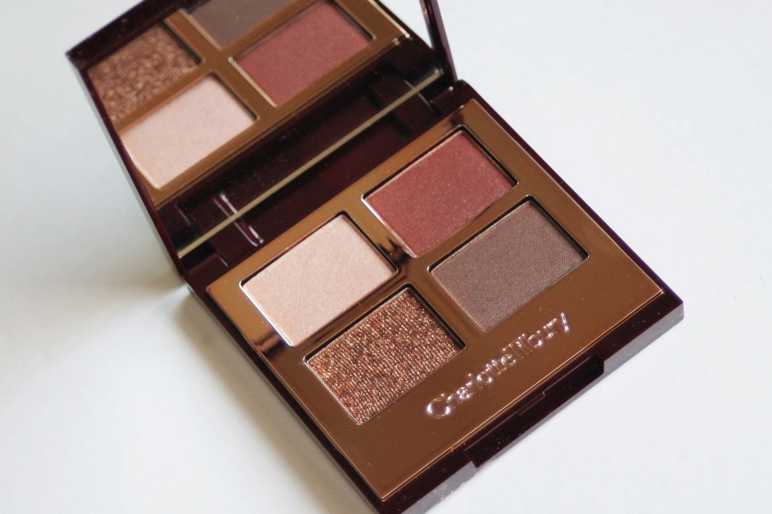
A Deep dive into Charlotte Tilbury
This Photo by Unknown Author is licensed under CC BY-NC-ND

Slide 9
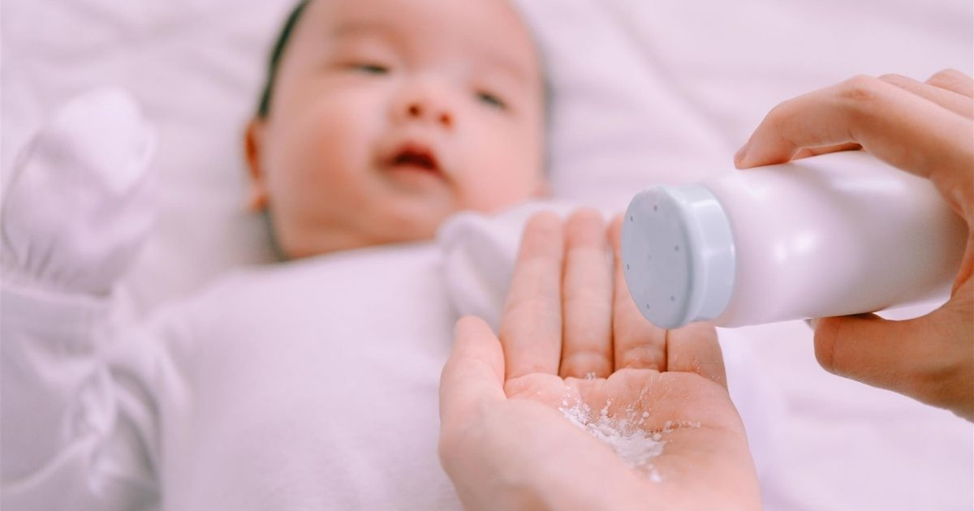


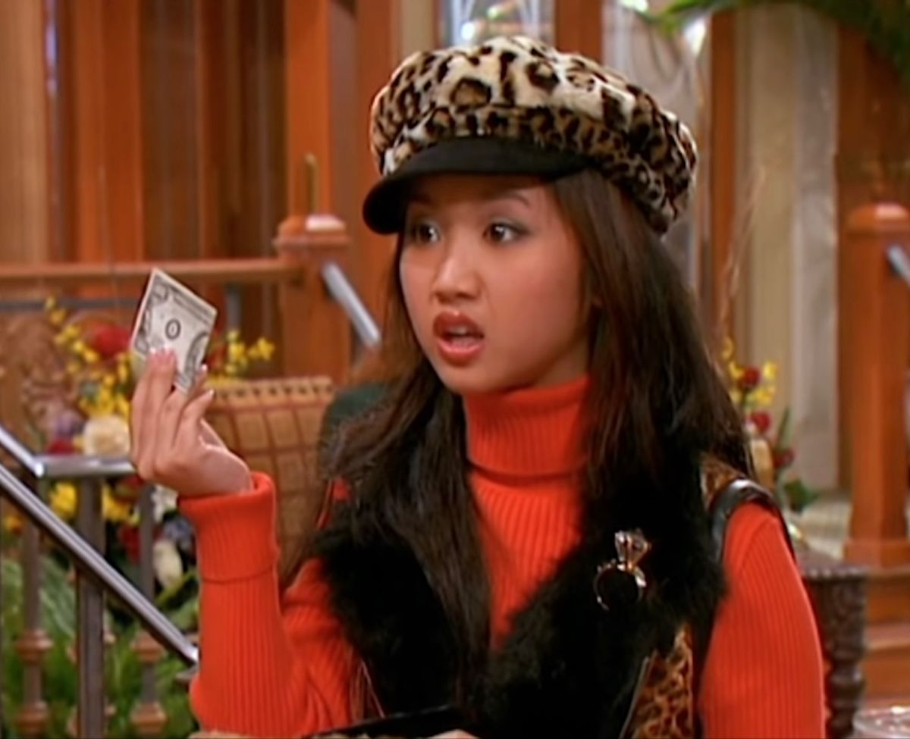
Target Demographics
The young (Over 16)
The wealthy
Frequent buyers
From major cities

Slide 10
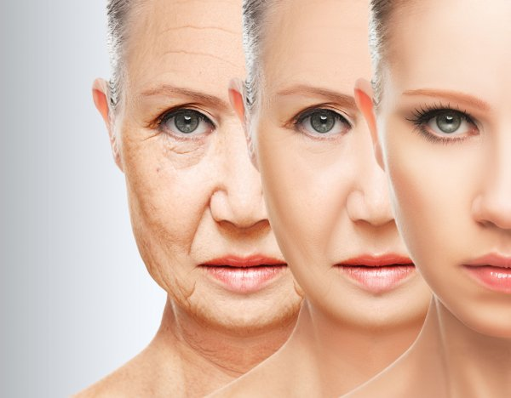
As participants changed
So did their opinions

Slide 11

The Wealthy

Slide 12
Can meaningful data be extracted based on proximity to major cities?
Notes:
NO.
Not enough participants living near major cities compared to those living away.
Not enough knowledge with US cities to group them together.

Slide 13
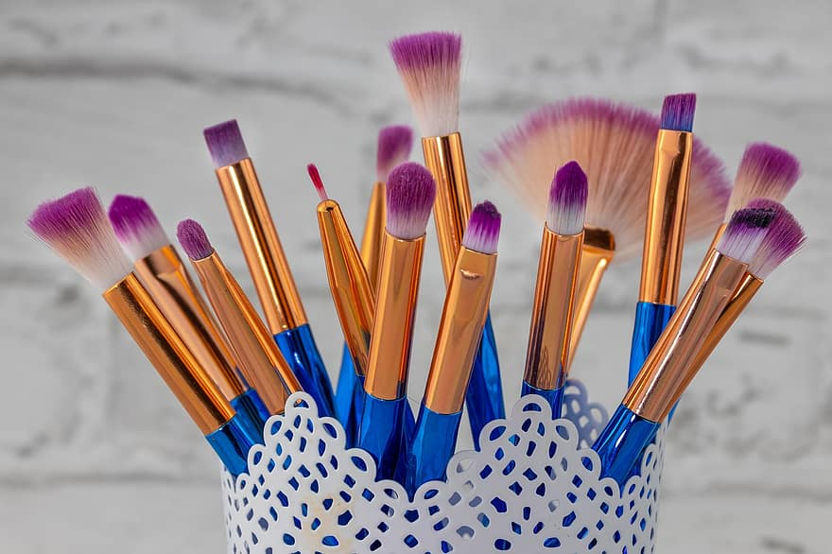
What influences Cosmetic’s biggest purchasers?

Slide 14

—SOMEONE FAMOUS
Methodology
«Keep It simple Stupid»

Slide 15
The complexity of the model should reflect the complexity of the data
Recipient opinions had a small domain of 5 with missing values and “Not sure” being mapped to neither agree nor disagree
As opinions go from Strongly disagree to strongly agree, the effect on recommendation is either strictly increasing or decreasing
There are less than 1500 entries in the data; therefore, the risk of overfitting with a more complex model is high
We only need to measure what factors contribute to a recommendation and our confidence in those factors

Slide 16
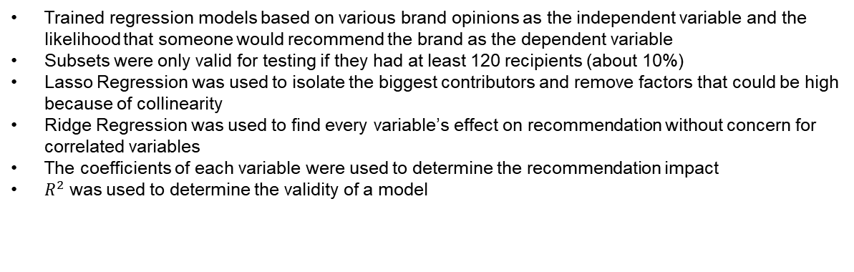
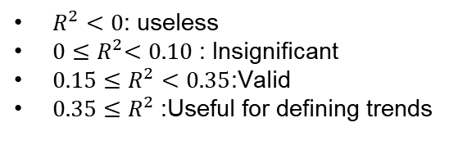
Linear Regression Models
Trained regression models based on various brand opinions as the independent variable and the likelihood that someone would recommend the brand as the dependent variable
Subsets were only valid for testing if they had at least 120 recipients (about 10%)
Lasso Regression was used to isolate the biggest contributors and remove factors that could be high because of collinearity
Ridge Regression was used to find every variable’s effect on recommendation without concern for correlated variables
The coefficients of each variable were used to determine the recommendation impact
$R^{2}$ was used to determine the validity of a model
$R^{2}<0$: useless
$0{≤R}^{2}<0.10$ : Insignificant
$0.15≤R^{2}<0.35$:Valid
$0.35≤R^{2}$:Useful for defining trends

Slide 17

Key Findings
Pride in supporting a brand was the most significant predictor of whether a customer would recommend it.
Unsurprisingly, product quality is important for recommendations.
Customers like it when selecting the product they need is easy.
Notes:
Talk about other general trends in the entire Charlotte subset. Only these 3 points need to be written on slides

Slide 18
Takeaways
Investigate what contributes to customers taking pride in a brand
Packaging must make it easy for customers to select what they need
In personalised advertisements, focus on the factors that were important to each demographic’s recommendation factor
To attract the big spenders, incorporate more female-empowering branding
In general, people don’t care if a product uses scientifically proven products: it could be enough to remake existing products with trending ingredients (coconut, aloe vera, etc) with exotic aromas to capture new audiences.

Slide 19

Next Steps
This presentation used less than 5% of the data available; it was only a demo of the valuable data that could be extracted.
Different Brands
Correlated opinions
Factors affecting whether someone would buy the product
A new dataset

Slide 20
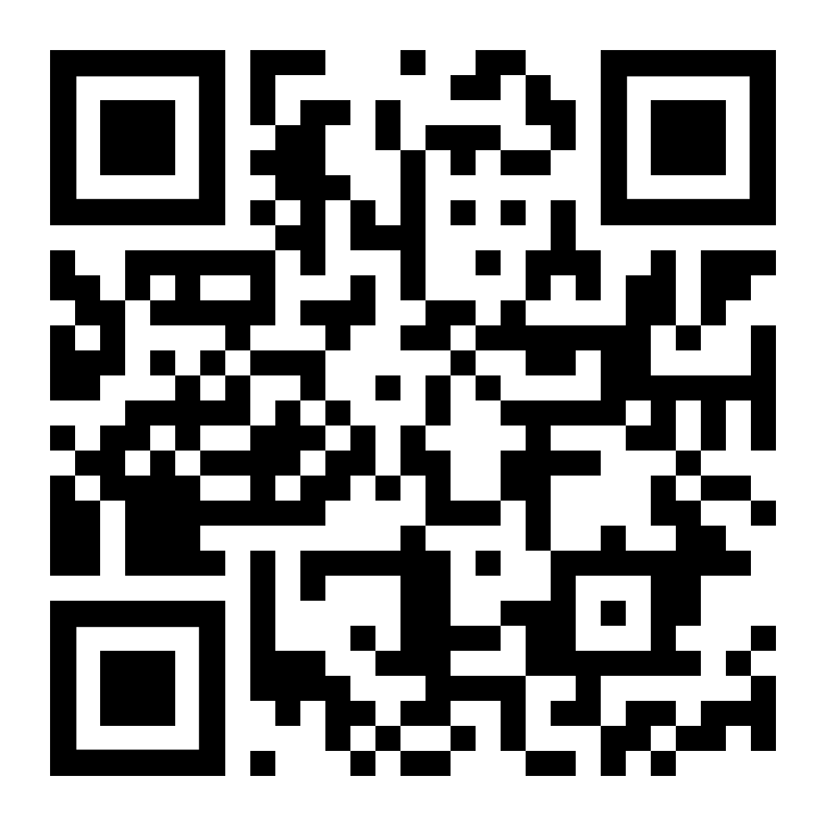
THANKS!
Do you have any questions?
info@slidesgo.com
+91 620 421 838
yourcompany.com
links to the GitHub repository
Please keep this slide for attribution

